Slide 1
Asthma and Stepwise Management
Student’s Name:
Institution:
Course:
Professor:
Date:

Slide 2
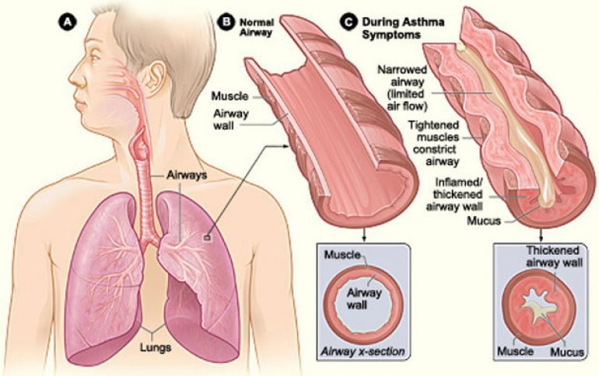
Introduction
Asthma is a critical health complication of breathing difficulties
It results from narrowed and swollen airways and excessive mucus production
The WHO data;
About 262 million people globally were diagnosed with Asthma in 2019
It also resulted in about 500,000 deaths
It has high prevalence in low and middle-income nations
Symptoms - chest tightness, wheezing and coughing, and sleep disturbance due to breathing difficulties
Notes:
Asthma is a critical health complication of breathing difficulties. It results from narrowed and swollen airways and excessive mucus production. The WHO data indicates that 262 million people globally were diagnosed with Asthma in 2019. It also resulted in about 500,000 deaths, with high prevalence in low and middle-income nations (World Health Organization, 2022). This results from public health challenges of underdiagnosis and lack of urgent and appropriate clinical interventions. Patients with this illness experience chest tightness, wheezing and coughing, and sleep disturbance due to breathing difficulties. The treatment options entail long-term asthma control medications and quick-relief (rescue) medications based on the severity of the patient's condition.

Slide 3
Treatment Options For The Asthma Patient
Long-term Control (LTC) Treatment Option
The LTC medication – entails daily prescriptions to reduce and prevent asthma attacks
It minimizes patients’ susceptibility to asthmatic complications that impact their daily activities
It entails;
Inhaled corticosteroids like fluticasone, budesonide, and mometasone
Leukotriene modifiers like zafirlukast and zileuton
Combination inhalers like fluticasone-salmeterol and fluticasone furoate-vilanterol
Theophylline for muscle relaxation along the airway
Notes:
The LTC medication for asthma patients entails daily prescriptions to reduce and prevent asthma attacks. It is the basic element of asthma treatment as it controls chronic symptoms and reduces airway inflammation (Zahran et al., 2017). As a result, patients are less susceptible to asthmatic complications that impact their daily activities. The LTC medications entail inhaled corticosteroids like fluticasone, budesonide, and mometasone that attain maximum benefit after several days. This prescription has minimal side effects compared to oral ones. Besides, Leukotriene modifiers like zafirlukast and zileuton are vital oral LTC drugs that relieve asthma complications. It also entails Combination inhalers like fluticasone-salmeterol and fluticasone furoate-vilanterol for long-term symptom control. Lastly, LTC entails Theophylline for muscle relaxation along the airway.

Slide 4
Quick Relief (QR) Treatment Option
The QR treatment constitutes fast-acting medicine for asthma complications
It is effective for the short-term management of symptoms
It entails;
Short-acting beta-agonists like albuterol and levalbuterol
Quick-relief bronchodilators
Anticholinergic agents like tiotropium
Oral and intravenous corticosteroids
Notes:
The QR treatment constitutes fast-acting medicine for asthma complications. It is effective for the short-term management of symptoms of asthma attacks (Butz et al., 2007). These medications entail short-acting beta-agonists like albuterol and levalbuterol, which are inhaled to ease the illness. They act as quick-relief bronchodilators and are taken through portable inhalers. Besides, QR options entail anticholinergic agents like tiotropium and offer immediate treatment for breathing difficulties by relaxing the airways. Furthermore, oral and intravenous corticosteroids are effective prescriptions for patients with severe asthma complications. This medication treats inflammation around the airways that result in shortness of breath. Even so, prolonged use of this drug triggers adverse side effects.

Slide 5
The Stepwise Approach to Asthma Treatment and Management
The Stepwise approach is vital for asthma treatment and management
It entails stepping up and stepping down medications
In this case;
The doctor prescribes a higher dosage after the first diagnosis
After that, the clinician lowers the prescriptions to levels that control and manage asthma symptoms
The doctor may step "up" or step "down" the treatment until he attains balance in the medication dose
Notes:
The Stepwise approach is vital for asthma treatment and management. It entails stepping up and stepping down medications due to the fluctuating symptoms of chronic asthma. In this case, the doctor prescribes a higher dosage after the first diagnosis to moderate the severity of the health condition (Khalid, 2015). This ensures the client regards their normal functioning abilities like proper sleep and breathing. The stepwise approach requires the doctor to adjust the treatment after achieving this goal. In this case, they lower the prescriptions to levels that control and manage asthma symptoms. At this point, the clinician may step "up" or step "down" the treatment until he attains balance in the medication dose. This varies based on the patient’s recovery progress.

Slide 6
The Importance of the Stepwise Management Approach
Stepwise management is vital in controlling symptom progression in chronic asthma
It assists the clinicians to;
Adjust the medication dosage based on the client's condition
It ensures constant monitoring of the patient's health
The patients benefit through;
Guaranteed access to quality and safe intervention
It enhances individualized care
Notes:
Stepwise management is vital in controlling symptom progression in chronic asthma. This approach assists both the patients and healthcare providers during this process. For instance, it requires clinicians to adjust the medication dosage based on the client's condition. This minimizes the risks of overtreatment and dosage errors (Khalid, 2015). It also ensures constant monitoring of the patient's health to address possible complications. Besides, the stepwise management approach guarantees asthma patients access to quality and safe intervention. It enhances individualized care, where doctors focus o patients' specific health needs.

Slide 7
Conclusion
Patients with asthma require urgent medical intervention to mitigate adverse complications
Severe asthma causes prolonged hospitalization and emergency room visits
The Long-term control (LTC) Treatment Option is vital for individuals with chronic asthma
Besides, the Quick Relief (QR) option for short-term relief of adverse asthma symptoms
The stepwise management approach helps to gain and maintain control of the disease
Notes:
Patients with asthma require urgent medical intervention to mitigate adverse complications like breathing difficulties and sleep interference. The condition also affects individuals' ability to engage effectively in their daily activities. Severe asthma complications may result in prolonged hospitalization and emergency room visits. For this reason, a patient must seek medical intervention to control and manage symptom progression. The Long-term control (LTC) Treatment Option is vital for individuals with chronic asthma. Besides, doctors recommend the Quick Relief (QR) option for short-term relief of adverse asthma symptoms. The stepwise management approach ensures that doctors and patients gain and maintain control of the disease.

Slide 8
References
Butz, A., Land, C., Walker, J., & Bollinger, M. E. (2007). Improving Asthma Communication With Inner City Parents: Does It Work? Journal of Allergy and Clinical Immunology, 119(1), S66. https://doi.org/10.1016/j.jaci.2006.11.281
Khalid, A. N. (2015). Stepwise management of asthma. International Forum of Allergy & Rhinology, 5(S1), S41–S44. https://doi.org/10.1002/alr.21606
World Health Organization. (2022, May 11). Asthma. WHO; World Health Organization. https://www.who.int/news-room/fact-sheets/detail/asthma
Zahran, H. S., Bailey, C. M., Qin, X., & Johnson, C. (2017). Long-term control medication use and asthma control status among children and adults with asthma. Journal of Asthma, 54(10), 1065–1072. https://doi.org/10.1080/02770903.2017.1290105

