Slide 1
Health Care Delivery in the United States PowerPoints to Accompany Health Care Delivery in the United States 12th Edition
Jonas & Kovner’s
12th Edition
James R. Knickman Brian Elbel Editors

Slide 2
Chapter 2: Organization of Care

Slide 3
Introduction
Health care delivery in the U.S.
Complex and multifaceted system
Private and public institutions operate in cooperation with, but largely independent of, each other.
No central governmental agency to control the delivery, yet government is the major purchaser of health care (e.g., Medicare, Medicaid, other public programs)
Heavily influenced through health care legislation
Continuum of care encompasses care from the cradle to the grave

Slide 4
Introduction (cont’d)
Issues facing individuals and organizations that provide health care:
Increasing pressure and scrutiny from the government, private insurance organizations, and the public
Expectation to provide the highest quality of care while controlling costs and increasing access to underserved populations
Need to adapt to meet the demands and mandates of health care policy and to survive and thrive

Slide 5
Description of the Current Care Delivery System
What is health?
“A state of complete physical, mental and social ‘well-being’ and not merely the absence of disease or infirmity.”¹
Health system
Includes all organizations, institutions, and resources that have a primary purpose of promoting, restoring, and/or maintaining health²
Includes care delivered through traditional clinical and public health settings and contributions to health from community organizations that have a stake in or can affect the health of individuals and communities
Purpose: contribute to improved health or to the diagnosis, treatment, or rehabilitation of sick people
Services include prevention, cure, rehabilitation, and palliation efforts oriented to either individuals or populations.
¹ World Health Organization. (2017). Constitution of WHO: Principles. Retrieved from http://www.who.int/about/mission/en
² World Health Organization. (2015). Health systems strengthening glossary. Retrieved from http://www.who.int/healthsystems/hss_glossary/en/index5.html

Slide 6
Health Care Services—Prevention
Focus: prevention of disease and maintenance of general good health
Health status is affected by a number of factors, including health policy, individual behavior, social determinants, physical determinants, biology and genetics, and availability of health services.
Major focus of the ACA
Most health plans cover a set of preventative services at no cost to the beneficiary.
New reimbursement mechanisms incentivize provider organizations to keep patients healthy.
Clinical prevention: delivered by a health care provider
Community-based prevention: delivered by non–health care providers
Holistic view incorporates cultural, social, and environmental changes³
³ Institute of Medicine. (2012). An integrated framework for assessing the value of community-based prevention. Washington, DC: National Academies Press.

Slide 7
Health Care Services—Prevention (cont’d)
Public Health
Function of federal, state, and local health departments
Address health concerns affecting the public at large (e.g., preventing epidemics, containing environmental hazards, promoting health living)
Community Health
Population Health
Focuses on health status indicators for a defined group of people
Focuses on collaboration among organizations (e.g., public health departments, health care delivery organizations, social service agencies, government entities) to address issues that impact the health of a community
ACA mandates that all nonprofit hospitals complete a community health needs assessment process every 3 years
Goal is to improve the health of the population and reduce inequities or disparities among population groups

Slide 8
Health Care Services—Prevention (cont’d)
Primary services: focus on preventing or reducing the probability of the occurrence of a disease in the future
Public and private institutions
Secondary services: focus on the early detection and treatment of disease in order to cure or control its effects
Goal is to minimize the effects of the disease on the individual
Services are largely focused on routine examinations and tests
Tertiary services: targeted at individuals who already have symptoms of a disease in order to prevent damage from the disease, slow down disease progression, prevent complications from occurring because of the disease, and restore good health to the affected individual
Includes education and institutional practices

Slide 9
Health Care Services—Acute Care
Short-term, intense medical care providing diagnosis and treatment of communicable or noncommunicable diseases, illness, or injury
Definitions of acute care vary.
May be described as primary, specialty, tertiary, or quaternary in nature, centered around the care delivered by physicians and other providers in clinical settings
Services may be provided on an outpatient or inpatient basis.
Outpatient: overnight stay is not required
Inpatient: overnight stay is required
Encompasses emergency care, trauma care, prehospital emergency care, acute care surgery, critical care, urgent care, and short-term inpatient stabilization

Slide 10
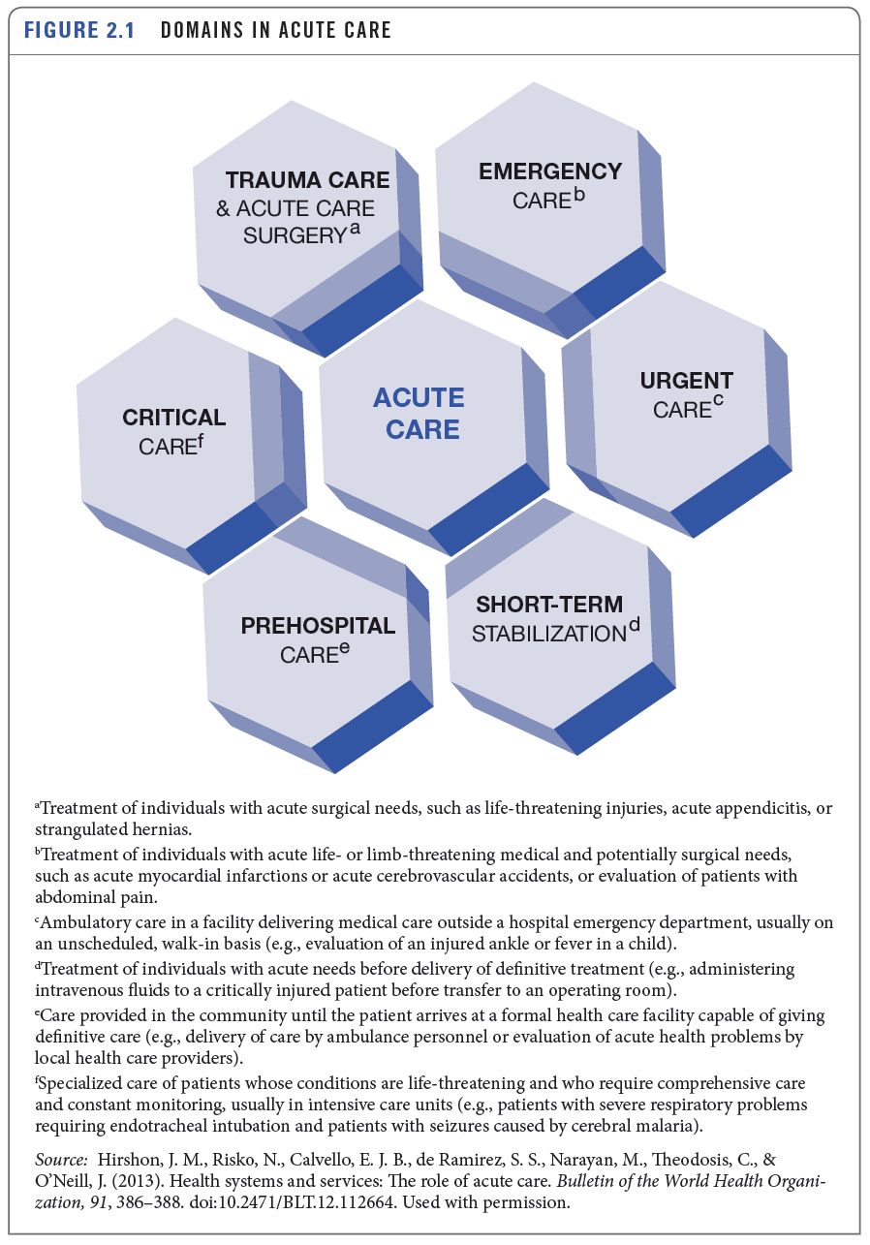
Health Care Services—Acute Care (cont’d)

Slide 11
Health Care Services—Acute Care (cont’d)
Emergency care
Emergency severity index
Five-level triage algorithm
Clinically stratifies patients into groups based on immediacy of the need to be seen
Emergency Severity Index
Immediate
(less than 1 minute)
Emergent
(1–14 minutes)
Urgent
(15–60 minutes)
Semiurgent
(61–120 minutes)
Nonurgent
(121 minutes–24 hours)

Slide 12
Health Care Services—Acute Care (cont’d)
Emergency care
Prehospital care
Primary care
Chronic care
Tertiary care
Quaternary care
Subacute inpatient care

Slide 13
Health Care Services
Rehabilitative care
Services are aimed at restoring a person to his or her original state of health (or as close as possible).
Long-term care
Encompasses a range of services and support provided to meet personal care needs on a long-term basis, most of which is not medical care
End-of-life care
Provided in the final hours or days of an individual’s life
Palliative care: treatment for discomfort, symptoms, and stress of serious illness, providing relief from pain, fatigue, nausea, shortness of breath, loss of appetite, or problems with sleep
Hospice care: end-of-life care used when a patient is expected to live 6 months or less

Slide 14
Health Care Delivery Organizations
Hospitals
An institution primarily engaged in providing, by or under the supervision of physicians, to inpatients, diagnostic and therapeutic services for medical diagnosis, treatment, and care of injured, disabled, or sick persons; or rehabilitation services for injured, disabled, or sick persons
Can be categorized in a number of ways, such as by purpose, size, ownership, location (urban or rural), teaching status, or system affiliation
Four primary categories for hospitals according to AHA:
Community
Special
Rehabilitative and chronic disease
Psychiatric

Slide 15
Health Care Delivery Organizations (cont’d)
Hospitals (cont’d)
Subject to federal and state regulations
Must be licensed to operate; licensing handled at the state level
Must receive certification from the federal government to receive reimbursement for services provided to Medicare and Medicaid patients
May voluntarily pursue accreditation by The Joint Commission
Federal government operates about 209 hospitals that are not accessible to the general public (e.g., Veterans Administration, Department of Defense, Indian Health Service).

Slide 16
Health Care Delivery Organizations (cont’d)
Physician organizations
Physicians may be employed by others (e.g., hospitals, government, medical schools) or be self-employed (i.e., in private practice).
Solo practice
Single specialty group practice
Multispecialty group practice
Corporate medical practice
Urgent care centers
Community health centers

Slide 17
Health Care Delivery Organizations (cont’d)
Ambulatory surgery centers (ASCs)
Provide outpatient surgical services
Long-term care organizations
Operate facilities for individuals who are not able to manage independently in the community
Independent living facilities
Assisted living facilities
Skilled nursing facilities

Slide 18
Health Care Delivery Organizations (cont’d)
Rehabilitation organizations
Inpatient facilities
Freestanding hospital
Unit in acute care hospital
Transitional care
Outpatient providers
Rehabilitation agencies
Rehabilitation clinics
Public health agencies

Slide 19
Health Care Delivery Organizations (cont’d)
Integrated delivery systems
Emergency medical services
Home health care organizations
Hospice and palliative care organizations
Pharmacies
Pharmaceutical companies and medical device manufacturers
Other delivery organizations
Telemedicine
Retail clinics

Slide 20
Health System Performance
The U.S. spends more money per capita on health care than any other nation in the world, yet we are lagging behind other countries on a variety of quality indicators (e.g., average life expectancy, infant mortality rates).
Crossing the Quality Chasm:⁴ landmark report released by the IOM that issued a mandate for improvement in U.S. health system performance
A portion of the ACA is dedicated to improving quality and health system performance through funding research, aligning financial incentives with performance outcomes, and identifying a national quality strategy.
⁴ Institute of Medicine. (2001). Crossing the quality chasm: A new health system for the 21st century. Washington, DC: National Academies Press.

Slide 21
Health System Performance (cont’d)
The Triple Aim
To improve the delivery of health care in the United States, organizations must simultaneously pursue three dimensions:
Improve the patient experience of care,
Improve the health of populations, and
Reduce the per-capita cost of health care.
Achieving this triple aim is difficult because one organization is rarely accountable for all three dimensions.
Five system components necessary for Triple Aim fulfillment:
Focus on individuals and families
Redesign primary care services/structures
Population health management
Cost control platform
System integration and execution

Slide 22
Health System Performance (cont’d)
Patient centeredness
Patient-centered care is “care that is respectful of and responsive to individual patient preferences, needs, and values and ensures that patient values guide all clinical decisions.”⁵
Six dimensions to patient-centered care have been identified:⁶
Respect for patients’ values, preferences, and expressed needs
Coordination and integration of care
Information, communication, and education
Physical comfort
Emotional support
Involvement of family and friends
⁵ Institute of Medicine. (2001). Crossing the quality chasm: A new health system for the 21st century. Washington, DC: National Academies Press.
⁶ Gerteis, M., Edgman-Levitan, S., & Daley, J. (1993). Through the patient’s eyes: Understanding and promoting patient-centered care. San Francisco, CA: Jossey-Bass.

Slide 23
Health System Performance (cont’d)
Population health management
Provider organizations are engaging in a variety of population health management activities that involve managing a patient’s care across provider settings.
Managing provider networks
Helping patients navigate physician and specialty care visits
Managing transitions of care
Provider organizations are beginning to invest in providing care within the home for seriously ill patients.
Provider organizations understand that chronic diseases are the primary drivers of death and disability in the United States.

Slide 24
The Future of the Delivery System
Innovative models of care delivery
Patient-centered medical homes
Health homes
Accountable care organizations
Community-based solutions
Clinical integration
Physician-hospital alignment
Physician employment models

Slide 25
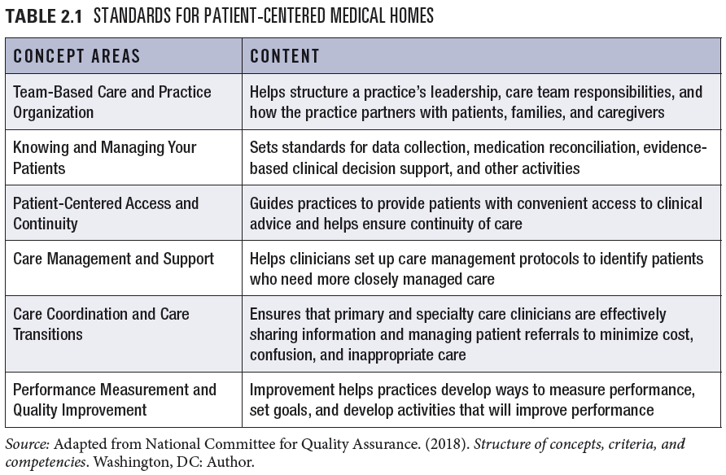
The Future of the Delivery System (cont’d)

Slide 26
Best Practices
Innovative approaches to improving care delivery
Intermountain Healthcare—Salt Lake City, Utah
Nonprofit health care system that nurtures a learning environment and culture of innovation
Has several initiatives centered around using technology and innovation to provide high-quality care at a sustainable cost
The Cleveland Clinic—Cleveland, Ohio
Multispecialty academic medical center with a focus on clinical care and research
Negotiating directly with self-insured employers as part of its Program for Advanced Medical Care; the idea is to allow employers to provide employees with access to world-class health care at a reasonable price

